Slide 1
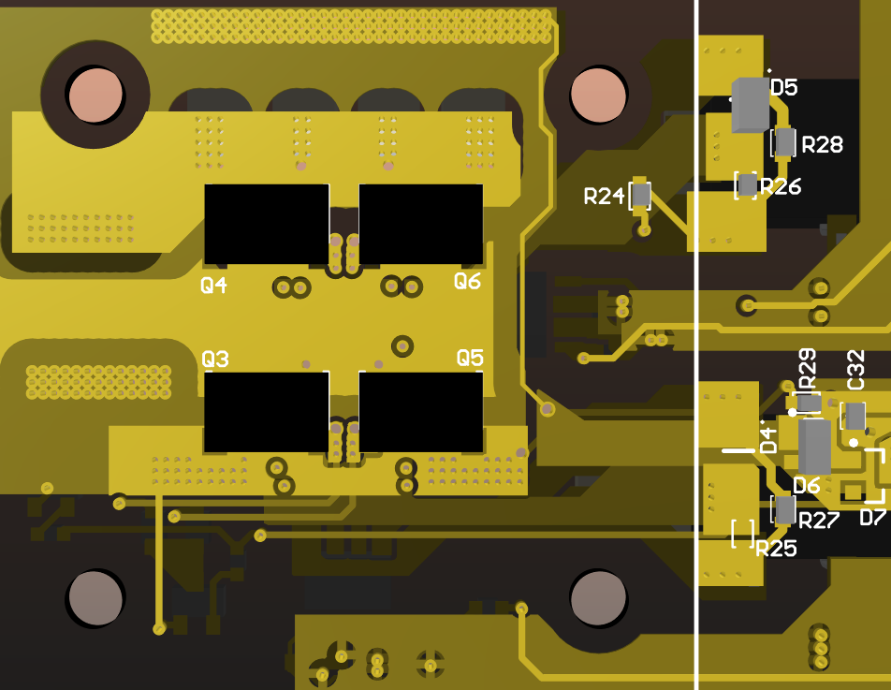
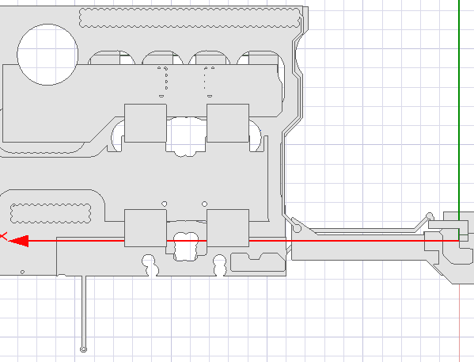
FEA Solutions for Mutual Coupling
Power Loop
 | Winding #1 | Winding #2 | Winding #3
Winding #1 | 1 nH | -0.21 nH | 1.59 pH
Winding #2 | -0.21 nH | 1.5 nH | 0.6 pH
Winding #3 | 1.59 pH | 0.6 pH | 4 fH
Winding #1
Winding #2
Is mutual coupling ineffective?
Winding #3

Slide 2
Who does start the mistrig?

Slide 3
Who does start the mistrig?

Slide 4
Who does start the mistrig?

Slide 5
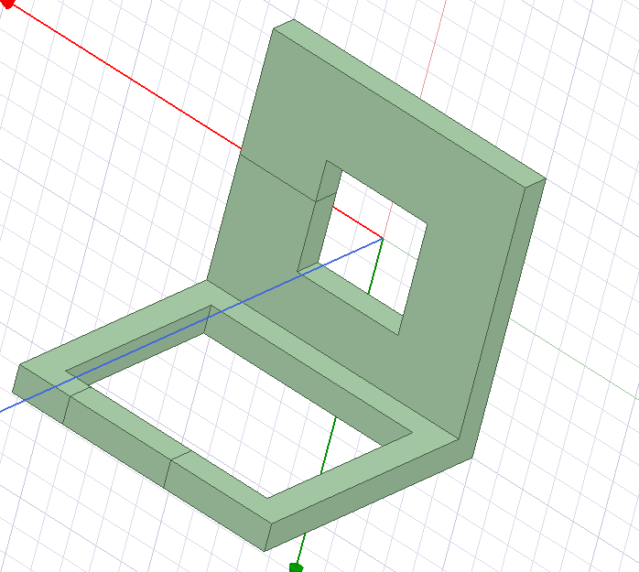
Layout Modeling
Sense Loop | Induced Voltage*
Winding Definition | 0.2 V
Insulating | 0.55 V
Power Loop Model
*For 3.7 A/ns slew rate
Sense Loop Model

